Slide 1
Dielectric Busbar Capacitors for IDT Coupling Adjustment
(6/18/2024)
Invention Disclosure Template Version 1.8

Slide 2
Invention Summary
Date Submitted: 6/18/2024
One Sentence Description (Title): Dielectric Busbar Capacitors for IDT Coupling Adjustment
Complete the table on the next page listing all inventors with their city of residence and their country of citizenship:
NOTE: it is important to include a thoughtful list of all the persons (inventors) that contributed inventive concepts to the patentable ideas (ideas both novel and useful), along with their city of residence and their country of citizenship.

Slide 3
Inventors
Name | City of Residence | Citizenship
Kurt Raihn | Grass Valley, CA | US
Jim Costa | Lompoc, CA | US
Sean McHugh | Santa Barbara, CA | US

Slide 4
Brief Description of the Invention
Describe the problem solved by this invention.
Electrical filters used in the processing of electrical signals are designed to pass desired signal frequencies while simultaneously blocking or attenuating undesirable electrical signal frequencies. Certain filter manufacturing techniques and material properties are best suited for specific bandwidth filters. These constraints limit the types of filters that can be designed. Implementing a dielectric busbar capacitor in series with SAW and/or BAW type IDT’s, the resonant frequency of the resonator can be shifted up in frequency, reducing the coupling and enabling the design of a narrower band filters not normally possible with the given manufacturing techniques and materials.
Explain any shortcomings of other existing approaches to solve this problem and how the new approach is better.
Other approaches to design narrower Surface Acoustic Wave (SAW) and/or Bulk Acoustic Wave (BAW) type passband filters require different manufacturing techniques and materials. This requires more materials in inventory and possibly different qualifications steps. Th different materials needed for the narrower band filters may also have diffenet electrical properties that could degrade performance.
The dielectric busbar capacitor uses the same materials and manufacturing techniques, eliminating the need to purchase and qualify new materials and processing.

Slide 5
Detailed Description of the Invention
Provide a step-by-step description of how the invention works.
Demonstrate quantitative improvement gained using this invention.
Include as many data, figures, and sources as possible.

Slide 6
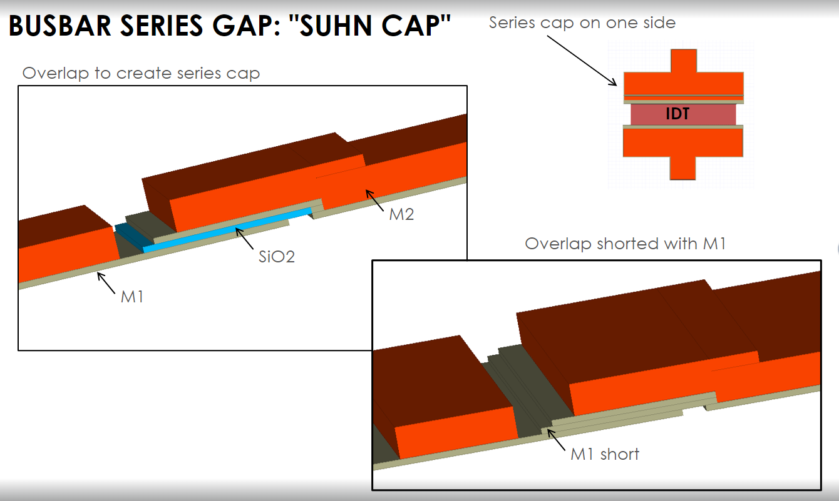
Reduced Coupling
The dielectric capacitor can be implemented on one or both sides of the IDT. Implementation of the series cap on one side of the IDT is shown in the figure below.
The amount of series capacitance can be adjusted by changing all or any combination of the following parameters:
Busbar width
Overlap length
Dielectric thickness
One side or two sides of the IDT

Slide 7
Capacitor Definitions
Series capacitor definitions are shown in the figure below.
Busbar length
Overlap width
Dielectric thickness
One side or two sides of the IDT
Dielectric Thickness (BLUE)
Busbar Length
Series cap on two sides
Overlap
width

Slide 8
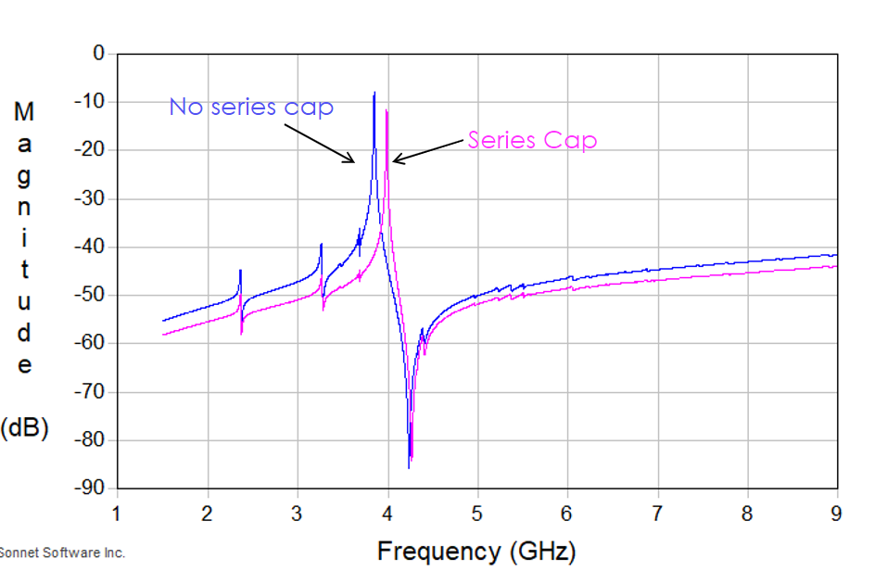
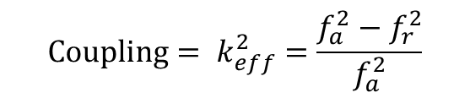
Reduced Coupling
Invention implementing a series cap. Admittance plot shows the reduced coupling with the addition of the series cap. Coupling is defined by the frequency spacing between the resonance and anti-resonance. A reduction in the spacing equates to a reduction in coupling allowing for narrower band filters to be designed.
Resonances (fr)
Definition of coupling
$$\text{Coupling}= k_{eff}^{2}=\frac{f_{a}^{2}−f_{r}^{2}}{f_{a}^{2}}$$
Admittance change reflects a smaller equivalent capacitance with the addition of the series capacitor.
Anti-resonances (fa)

Slide 9
mBVD Capacitance
Low Frequency
Evaluate equivalent capacitances at low and high frequencies for an mBVD model.
Z_{L} = jωL = 2*pi*f*L
As f → 0 , Z_{L} → 0
Ceq = C0 + Cm
Cm
short
mBVD
Lm
Cm
C0
High Frequency
Z_{L} = jωL = 2*pi*f*L
As f → ∞ , Z_{L} → ∞
Ceq = C0
Cm
open
C0
C0

Slide 10
mBVD Capacitance with series capacitor
Evaluate equivalent capacitances at low and high frequencies for an mBVD model.
Low Frequency
Z_{L} = jωL = 2*pi*f*L
As f → 0 , Z_{L} → 0
1/Ceq = 1/Cseries + 1/(C0 + Cm)
Cm
short
mBVD with series cap
Cseries
C0
Lm
Cm
High Frequency
Z_{L} = jωL = 2*pi*f*L
As f → ∞ , Z_{L} → ∞
1/Ceq = 1/Cseries + 1/C0
Cm
Cseries
open
C0
Cseries
C0

Slide 11
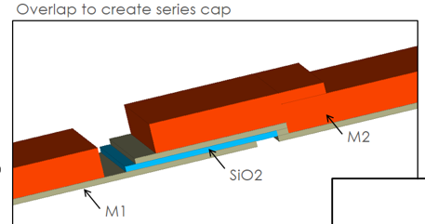
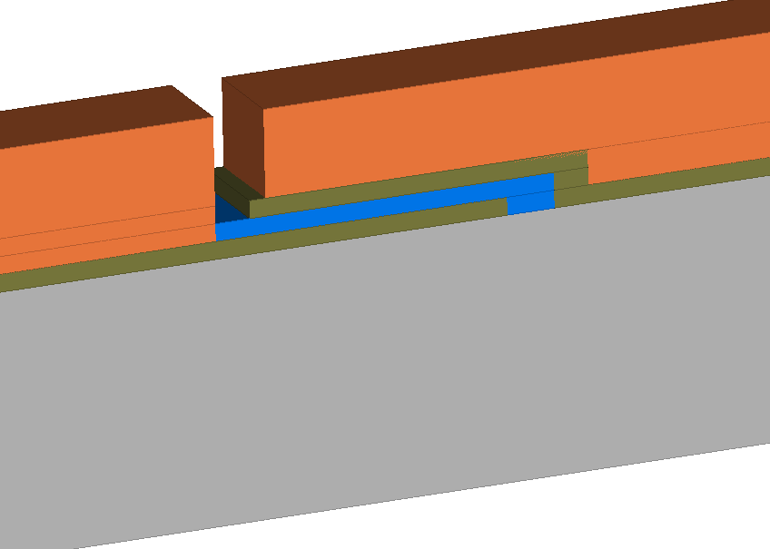
Further Nuance – Suhn Cap
M1-Oxide-M1 cap
Silicon Oxide can fill this gap

Slide 12
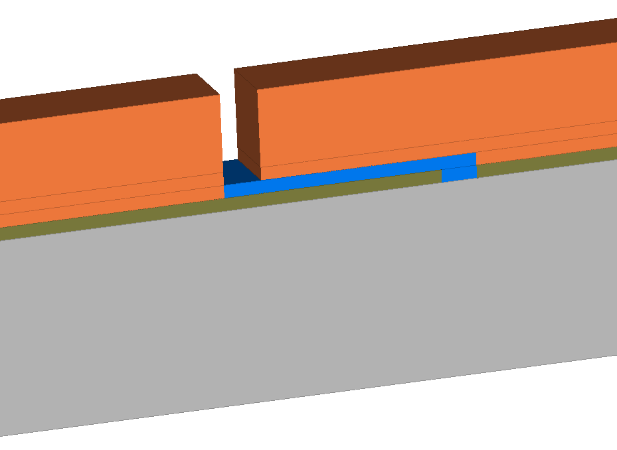
Further Nuance – Suhn Cap
M1-Oxide-M2 cap
This layer can be a part of M2, rather than adding M1 on top of SiO2.

Slide 13
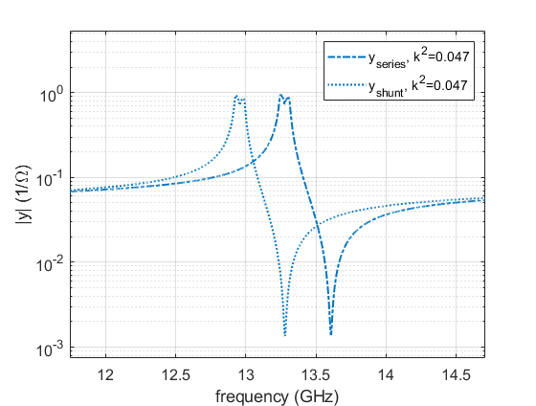
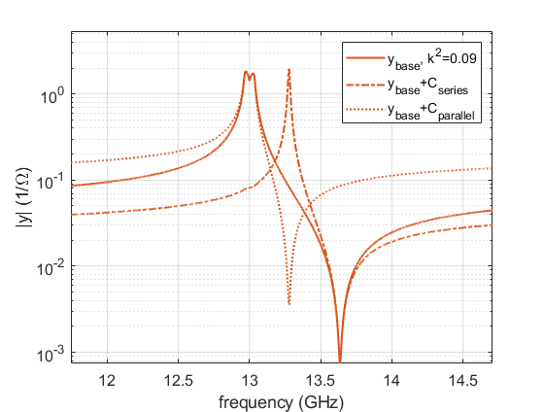
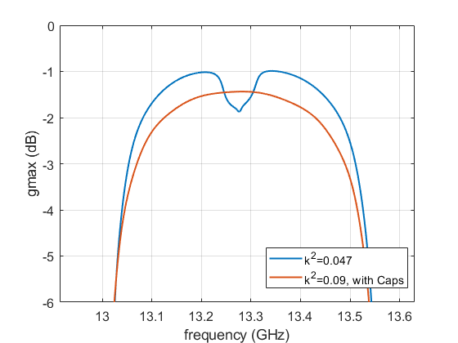
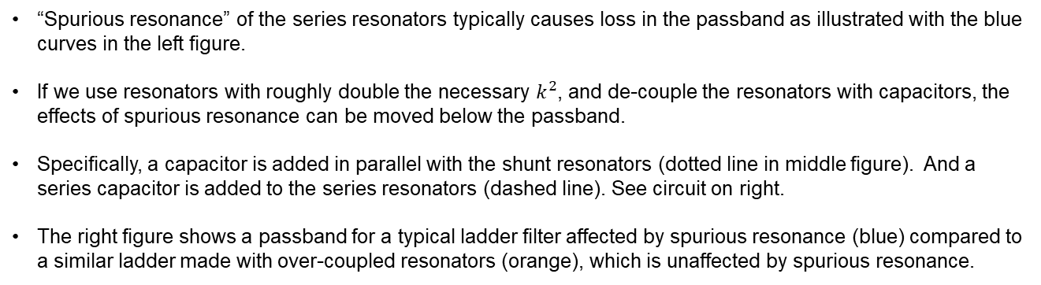
Further Nuance: Over-coupled resonators to mitigate spurious resonance
“Spurious resonance” of the series resonators typically causes loss in the passband as illustrated with the blue curves in the left figure.
If we use resonators with roughly double the necessary $k^{2}$, and de-couple the resonators with capacitors, the effects of spurious resonance can be moved below the passband.
Specifically, a capacitor is added in parallel with the shunt resonators (dotted line in middle figure). And a series capacitor is added to the series resonators (dashed line). See circuit on right.
The right figure shows a passband for a typical ladder filter affected by spurious resonance (blue) compared to a similar ladder made with over-coupled resonators (orange), which is unaffected by spurious resonance.
Note, this extra loss is unnecessary and would be eliminated with a more careful design.

Slide 14
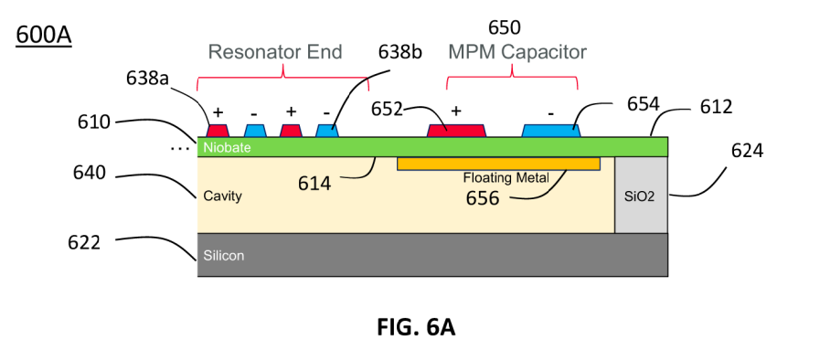
Summarize Relevant Documents
S24-0537
Identify any publications (articles, patents, patent applications, books, etc.) that may be relevant to the subject matter of your invention.
S24-0537 cites:
US20190363692A1 (shows series capacitor in series with series resonator, but not that the capacitor is integrated into the busbar).
US20220247382A1 (shows a capacitor in parallel by way of extending a wireline between the busbars, but not in series within the busbar itself)
US20180048290A1 (a Metal Insulator Metal (MIM) capacitor C is shown, but not one that is integrated into busbar)
US20220014167A1(a MIM is shown but not integrated into busbar)
US20130083044A1 (shows a “DMR” that has a capacitance value, but not integrated into the busbar)
“Furthermore, I think it is unreasonable to come up with "SUHN Cap" from the structure of Document 5 and the MIM capacitors of Documents 2, 3, and 4.”
S24-1491 cites
US20190363692A1 (shows series in series OR shunt in parallel, but not both, and not for over coupled resonators)
US8751993B1 (shows series cap in series with series resonator, but not over coupled)
US20220247382A1 (shows series resonators with cap in parallel, and shunt resonators with cap in parallel, but not over coupled resonators).
US20170214389A1 (shows series resonators with capacitor in series, but not also the shunt resonator with a cap in shunt, and not over coupled resonators)
U.S. 63/529,541, filed on July 28, 2023. This is a Metal Piezo Metal capacitor in parallel to the IDT. Currently this is being drafted into a full utility. However, this case is not in series with the IDT, nor is it integrated into the busbar of the IDT as in this case.

Slide 15
Worked Example showing utility of invention
Include at least one complete example of how the invention was put into practice
Include equations, plots, measured data, and other supporting material

